Slide 1
Bankruptcy Prevention Model
Presented by: Group 4 and Team
Organization: ExcelR Institutions
Date: 25.02.2025

Slide 2
Introduction
What is Bankruptcy?
Why is it Important to Predict Bankruptcy?
Objective of the Project

Slide 3
What is Bankruptcy?
Business failure due to financial distress, mismanagement, or economic downturns.
Why is it Important to Predict Bankruptcy?
Helps businesses take proactive measures.
Reduces financial losses and ensures long-term stability.

Slide 4
Objective of Project:
Develop a machine learning model to predict bankruptcy based on different risks.
Enable businesses to make informed decisions to improve financial health and avoid collapses.
Identify businesses at risk before financial distress becomes irreversible.

Slide 5
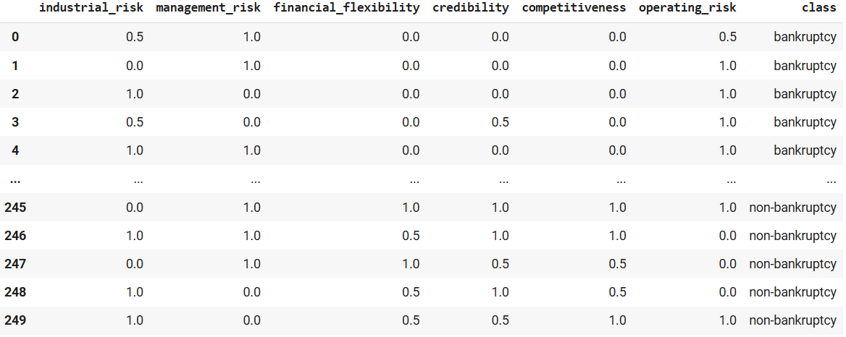
Dataset:

Slide 6
Dataset and Features:
Dataset includes 7 columns 6 features and 1 target column.
Features in dataset are ‘industrial_risk’, ‘management_risk’, ‘financial_flexibility’, ‘credibility’, ‘competitiveness’, ‘operating_risk’ and Target column being ‘class’.
Dataset has entries of 250 different companies. 103 of them being unique.
Entries for features include 0.0 , 0.5 , 1.0 , where 0 is low risk , 0.5 is medium risk and 1.0 is high risk.
Entries for target include ‘bankruptcy’ and ‘non-bankruptcy’ which tells us about the class each company data belong to.

Slide 7
Feature Detail:
Management Risk: This feature tells us the risk involved in management of the company. 0 being the lowest risk and 1 being the highest risk.
Industry Risk: This feature tells us the risk involved in the industry the company does the business in. 0 being the lowest risk and 1 being the highest risk.
Financial Flexibility: This feature tells us about the flexibility of the company in terms of it’s financials'. 0 being company has less flexibility and 1 being company has high flexibility.
Credibility: This feature tells us about the company’s public image and how people view the company. 0 being low credibility meaning people have bad view about the company and 1 being high credibility meaning people have good view about the company.
Competitiveness: This feature tells us about how competitive the company is in the industry. 0 being the company is less competitive and 1 being the company being highly competitive.
Operating Risk: This feature tells us the risk involved in operations of the company. 0 being the lowest risk and 1 being the highest risk.

Slide 8
Methodology:
Steps Followed:
Data Collection – Financial records and historical bankruptcy data.
Data Preprocessing – Handling missing and duplicate data, standardization.
Feature Selection – Identifying key features for prediction.
Model Selection – Comparing ML models.
Model Training & Evaluation – Optimizing for best performance.

Slide 9
EDA: Exploratory Data Analysis
Purpose of EDA
Understand the dataset structure, distributions, and patterns.
Detect missing values, outliers, and inconsistencies.
Identify relationships between features and the target variable.

Slide 10
Key Insights
Target column is positively correlated with 3 columns management, industrial and operating risk and is negatively correlated with Credibility, Competitiveness and Financial flexibility when bankruptcy is encoded 0 and non-bankruptcy is encoded 1.
When data is small the model seems to overfit. Collecting large dataset will tend to stop this get better model that will detect more hidden patterns.

Slide 11
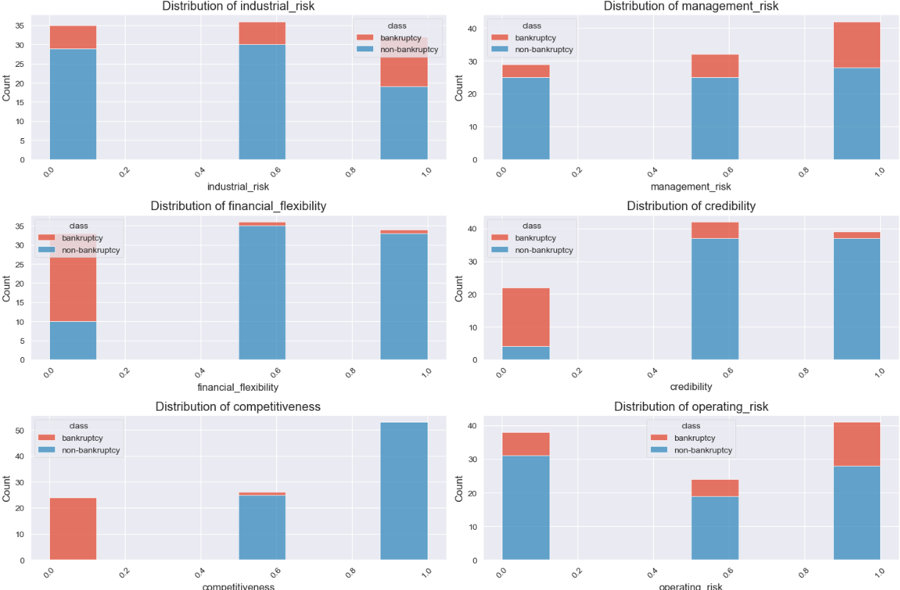
Feature Distribution: Visualizing features distribution

Slide 12
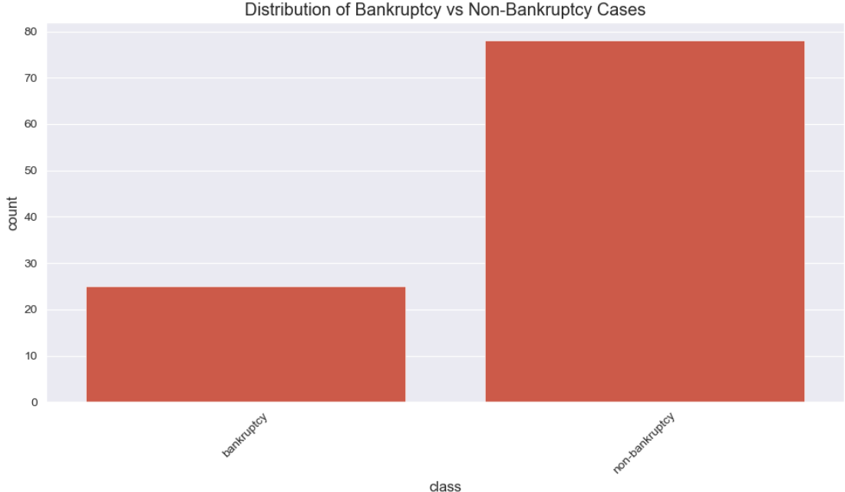
Class Distribution: (After deleting duplicates)

Slide 13
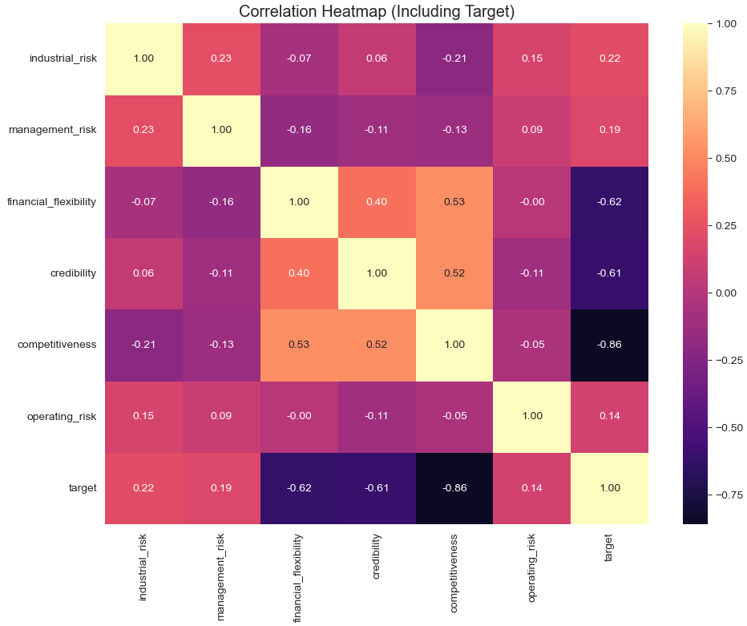
Using Heatmap for Correlation:

Slide 14
Model Selection & Performance
Models developed:
Random forest
Logistic Regression
SVM
Decision Tree
XGB

Slide 15
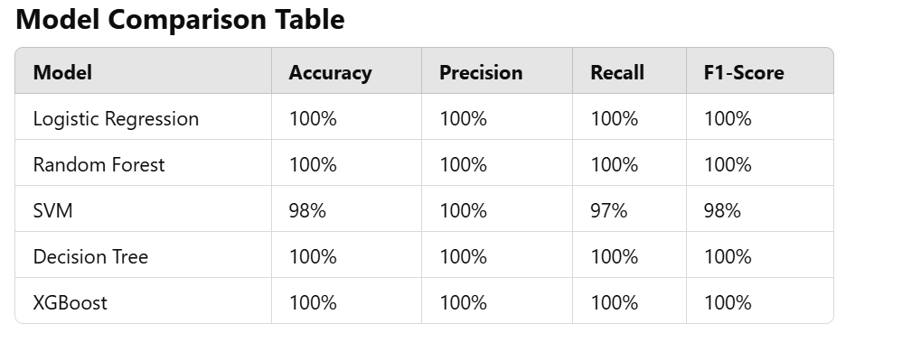

Slide 16
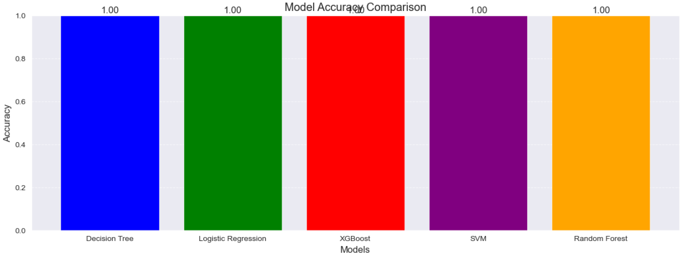
Model Accuracies:

Slide 17
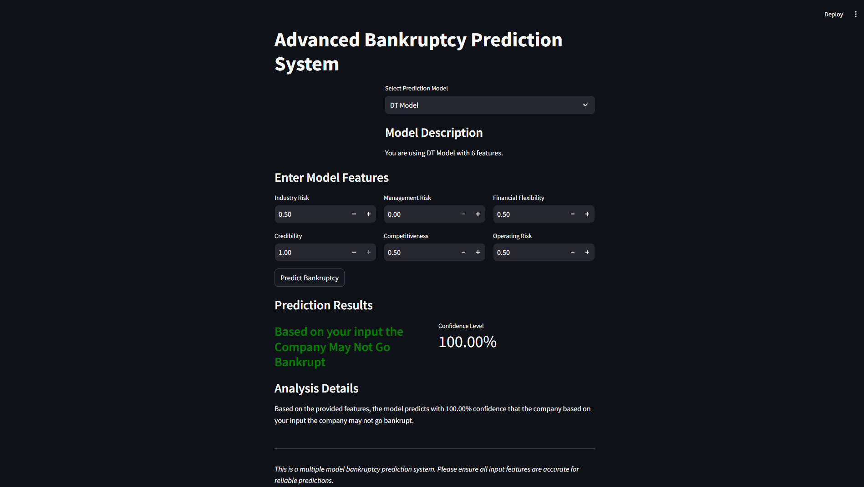
Streamlit UI

Slide 18
Deployment:
Web application using Streamlit/Flask for real-time predictions.
We have put all our 5 models in app and the users will be able to select the model they want and also confidence level of the prediction will be displayed.
Future Enhancements:
Deep Learning for better predictions.
Expanding dataset for higher accuracy.

Slide 19
Challenges faced:
Class imbalance : Can be tackled by using SMOTE to resample and balance the data.
Data Starvation : Can be tackled by taking large dataset.
Feature selection complexity : Can be tackled by performing PCA.
Model overfitting : Can be tackled by having large dataset and doing good feature selection.

Slide 20
Proactive Measures to Prevent Bankruptcy
Key Strategies:
Optimize Cash Flow – Reduce unnecessary expenses and improve revenue streams.
Debt Management – Reduce high-interest liabilities.
Diversification – Expand products/services to reduce market risk.
Technology & Innovation – Automate operations to improve efficiency.

Slide 21
Conclusion
Machine learning helps in early bankruptcy prediction.
Preventive measures can reduce business failure risks.

Slide 22
Thank you

